Slide 1
What Every Data Programmer
Needs to Know about Disks
OSCON Data – July, 2011 - Portland
Ted Dziuba
@dozba
tjdziuba@gmail.com
Not proprietary or confidential. In fact, you’re risking a career by listening to me.

Slide 2




Who are you and why are you talking?
First job: Like college but they pay you to go.
A few years ago: Technical troll for The Register.
Recently: Co-founder of Milo.com, local shopping engine.
Present: Senior Technical Staff for eBay Local

Slide 3
The Linux Disk Abstraction
Volume
/mnt/volume
File System
xfs, ext
Block Device
HDD, HW RAID array

Slide 4
What happens when you read from a file?
f = open(“/home/ted/not_pirated_movie.avi”, “rb”)
avi_header = f.read(56)
f.close()
user
buffer
page
cache
Disk
controller
platter

Slide 5
What happens when you read from a file?
user
buffer
page
cache
Disk
controller
platter
Main memory lookup
Latency: 100 nanoseconds
Throughput: 12GB/sec on good hardware
Notes:
Note that the page is actually in memory twice. Mmaped files fix this, but it’s beyond the scope of this discussion.
Also this is why read performance on a lot of memory only NoSQL databases beats disk-backed SQL. Duh.

Slide 6
What happens when you read from a file?
user
buffer
page
cache
Disk
controller
platter
Needs to actuate a physical device
Latency: 10 milliseconds
Throughput: 768 MB/sec on SATA 3
(Faster if you have a lot of money)

Slide 7
Sidebar: The Horror of a 10ms Seek Latency
A disk read is 100,000 times slower than a memory read.
100 nanoseconds
Time it takes you to write a really clever tweet
10 milliseconds
Time it takes to write a novel, working full time
Notes:
Equate 100 nanoseconds to about 100 seconds. Then 10 milliseconds is about 3 months.

Slide 8
What happens when you write to a file?
f = open(“/home/ted/nosql_database.csv”, “wb”)
f.write(key)
f.write(“,”)
f.write(value)
f.close()
user
buffer
page
cache
Disk
controller
platter

Slide 9
What happens when you write to a file?
f = open(“/home/ted/nosql_database.csv”, “wb”)
f.write(key)
f.write(“,”)
f.write(value)
f.close()
user
buffer
page
cache
Disk
controller
platter
Mark the page dirty,
call it a day and go have a smoke.
You need to make this
part happen
Notes:
This is where a lot of NoSQL databases get their performance, but more on that in a few minutes.

Slide 10
Aside: Stick your finger in the Linux Page Cache
Pre-Linux 2.6 used “pdflush”, now per-Backing Device Info (BDI) flush threads
Dirty pages: grep –i “dirty” /proc/meminfo
/proc/sys/vm Love:
dirty_expire_centisecs : flush old dirty pages
dirty_ratio: flush after some percent of memory is used
dirty_writeback_centisecs: how often to wake up and start flushing
Clear your page cache: echo 1 > /proc/sys/vm/drop_caches
Crusty sysadmin’s hail-Mary pass: sync; sync; sync
Notes:
There are threads that wake up every now and then to flush pages to disk.

Slide 11
Fsync: force a flush to disk
f = open(“/home/ted/nosql_database.csv”, “wb”)
f.write(key)
f.write(“,”)
f.write(value)
os.fsync(f.fileno())
f.close()
user
buffer
page
cache
Disk
controller
platter
Also note, fsync() has a cousin, fdatasync() that does not sync metadata.
Notes:
Fsync blocks until the data has been written to disk.

Slide 12
Aside: point and laugh at MongoDB
Mongo’s “fsync” command:
> db.runCommand({fsync:1,async:true});
wat.
Also supports “journaling”, like a WAL in the SQL world, however…
It only fsyncs() the journal every 100ms…”for performance”.
It’s not enabled by default.

Slide 13
Fsync: bitter lies
f = open(“/home/ted/nosql_database.csv”, “wb”)
f.write(key)
f.write(“,”)
f.write(value)
os.fsync(f.fileno())
f.close()
user
buffer
page
cache
Disk
controller
platter
Drives will lie to you.

Slide 14
Fsync: bitter lies
page
cache
Disk
controller
platter
…it’s a cache!
Two types of caches: writethrough and writeback
Writeback is the demon

Slide 15
(Just dropped in) to see what condition your caches are in
A Typical Workstation
Disk
controller
platter
No controller cache
Writeback cache on disk

Slide 16
(Just dropped in) to see what condition your caches are in
A Good Server
Disk
controller
platter
Writethrough cache
on controller
Writethrough cache on disk

Slide 17
(Just dropped in) to see what condition your caches are in
An Even Better Server
Disk
controller
platter
Battery-backed writeback
cache on controller
Writethrough cache on disk
Notes:
With a battery-backed RAID controller, fsync can return very quickly with little risk of data loss.

Slide 18
(Just dropped in) to see what condition your caches are in
The Demon Setup
Disk
controller
platter
Battery-backed writeback
cache or
Writethrough cache
Writeback cache on disk
Notes:
You need to dive into your vendor’s control tool to find this out.

Slide 19
Disks in a virtual environment
The Trail of Tears to the Platter
user
buffer
page
cache
Virtual
controller
Hypervisor
Physical
controller
Host
page
cache
platter
Notes:
VMWare server is faithful to fsync, VMWare workstation is not. Xen usually queues I/O requests after they have been issued. The point is that you have no way of knowing. Your visibility of what happens to your data after you write or fsync ends at the hypervisor.

Slide 20
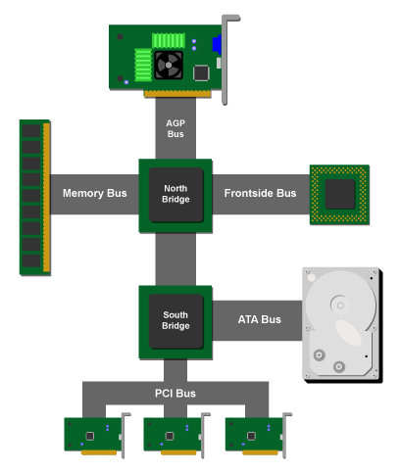
Disks in a virtual environment
Why EC2 I/O is Slow and Unpredictable
Shared Hardware
Physical Disk
Ethernet Controllers
Southbridge
How are the caches configured?
How big are the caches?
How many controllers?
How many disks?
RAID?
Image Credit: Ars Technica
Notes:
Newer intel chips have the northbridge controller on-die. Southbridge bandwidth is usually <= 10GB/sec, and you are sharing this with other customers’ network and disk I/O. That, and you may be sharing drive spindles.

Slide 21
Aside: Amazon EBS
MySQL
Amazon EBS
Please stop doing this.
Notes:
EBS lies about the result of fsync. This is why Reddit is down all the time. You have been warned.

Slide 22
What’s Killing That Box?
ted@u235:~$ iostat -x
Linux 2.6.32-24-generic (u235) 07/25/2011 _x86_64_ (8 CPU)
avg-cpu: %user %nice %system %iowait %steal %idle
0.15 0.14 0.05 0.00 0.00 99.66
Device: rrqm/s wrqm/s r/s w/s rsec/s wsec/s avgrq-sz %util
sda 0.00 3.27 0.01 2.38 0.58 45.23 19.21 0.24
Notes:
EBS lies about the result of fsync. This is why Reddit is down all the time. You have been warned.

Slide 23
Cool Hardware Tricks
Beginner Hardware Trick: SSD Drives
$2.50/GB vs 7.5c/GB
Negligible seek time vs 10ms seek time
Not a lot of space

Slide 24
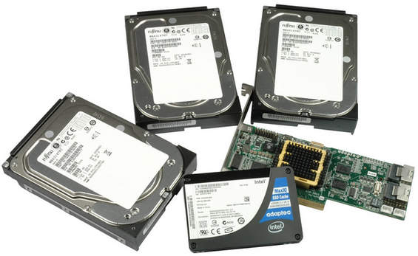
Cool Hardware Tricks
Intermediate Hardware Trick: RAID Controllers
Standard RAID Controller
SSD as writeback cache
Battery-backed
Adaptec “MaxIQ”
$1,200
Image Credit: Tom’s Hardware

Slide 25
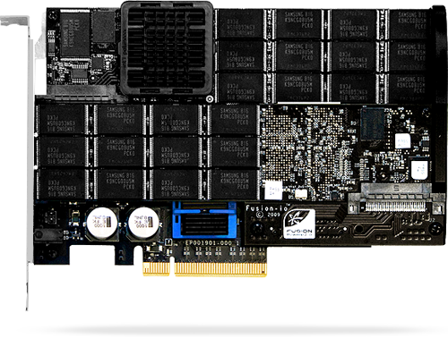
Cool Hardware Tricks
Advanced Hardware Trick: FusionIO
SSD Storage on the Northbridge (PCIe)
6.0 GB/sec throughput. Gigabytes.
30 microsecond latency (30k ns)
Roughly $20/GB
Top-line card > $100,000 for around 5TB

Slide 26
Questions
Questions & Heckling
Thank You
http://teddziuba.com/
@dozba

